Slide 1


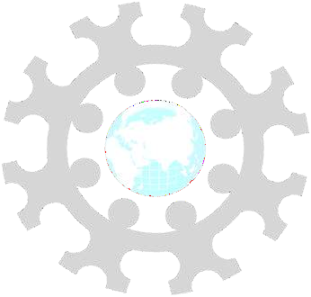
INSTITUTE: UIE (AIT-CSE)
CSS21: B.E. CSE (H) with specialization in
Artificial Intelligence & Machine Learning
Advanced Machine Learning (20CSF-349)
Chapter 3.2.1 & 3.2.2: Clustering
Lecture 40 & 41: K-Means Clustering & Hierarchical Clustering
By: Mr. Siddharth Kumar
DISCOVER . LEARN . EMPOWER

Slide 2
Advanced Machine Learning
Course Outcome
CO | Title
1 | Have a good understanding of the fundamental issues and challenges of machine learning: data, model selection, model complexity, etc.
2 | Appreciate the underlying mathematical relationships within and across Machine Learning algorithms and the paradigms of supervised and un-supervised learning
3 | Design and implement various machine learning algorithms in a range of real-world applications.
4 | Design and evaluate intelligent expert models for perception and prediction using machine learning algorithms
5 | Analyze and make use of machine learning algorithms-based applications using performance

Slide 3
K-Means Clustering
K-Means Clustering is an unsupervised learning algorithm that is used to solve the clustering problems in machine learning or data science. In this topic, we will learn what is K-means clustering algorithm, how the algorithm works, along with the Python implementation of k-means clustering.
What is K-Means Algorithm?
K-Means Clustering is an Unsupervised Learning algorithm, which groups the unlabeled dataset into different clusters. Here K defines the number of pre-defined clusters that need to be created in the process, as if K=2, there will be two clusters, and for K=3, there will be three clusters, and so on.
It is an iterative algorithm that divides the unlabeled dataset into k different clusters in such a way that each dataset belongs only one group that has similar properties.
It allows us to cluster the data into different groups and a convenient way to discover the categories of groups in the unlabeled dataset on its own without the need for any training.
It is a centroid-based algorithm, where each cluster is associated with a centroid. The main aim of this algorithm is to minimize the sum of distances between the data point and their corresponding clusters.

Slide 4
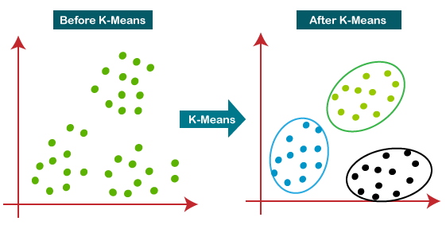
The algorithm takes the unlabeled dataset as input, divides the dataset into k-number of clusters, and repeats the process until it does not find the best clusters. The value of k should be predetermined in this algorithm.
The k-means clustering algorithm mainly performs two tasks:
Determines the best value for K center points or centroids by an iterative process.
Assigns each data point to its closest k-center. Those data points which are near to the particular k-center, create a cluster.
Hence each cluster has datapoints with some commonalities, and it is away from other clusters.
The below diagram explains the working of the K-means Clustering Algorithm:

Slide 5
How does the K-Means Algorithm Work?
The working of the K-Means algorithm is explained in the below steps:
Step-1: Select the number K to decide the number of clusters.
Step-2: Select random K points or centroids. (It can be other from the input dataset).
Step-3: Assign each data point to their closest centroid, which will form the predefined K clusters.
Step-4: Calculate the variance and place a new centroid of each cluster.
Step-5: Repeat the third steps, which means reassign each datapoint to the new closest centroid of each cluster.
Step-6: If any reassignment occurs, then go to step-4 else go to FINISH.
Step-7: The model is ready.
Let's understand the above steps by considering the visual plots:
Suppose we have two variables M1 and M2. The x-y axis scatter plot of these two variables is given below:

Slide 6
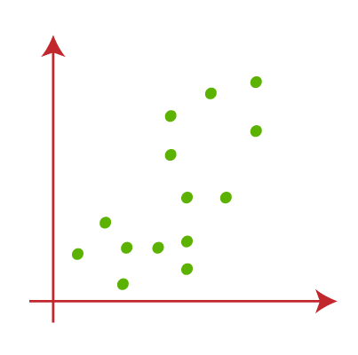
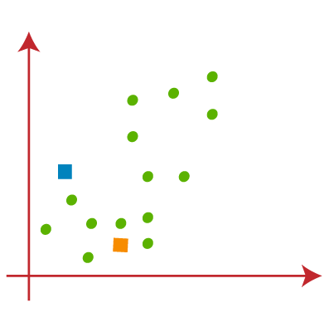
Let's take number k of clusters, i.e., K=2, to identify the dataset and to put them into different clusters. It means here we will try to group these datasets into two different clusters.
We need to choose some random k points or centroid to form the cluster. These points can be either the points from the dataset or any other point. So, here we are selecting the below two points as k points, which are not the part of our dataset. Consider the image:
Now we will assign each data point of the scatter plot to its closest K-point or centroid. We will compute it by applying some mathematics that we have studied to calculate the distance between two points. So, we will draw a median between both the centroids. Consider the image:

Slide 7
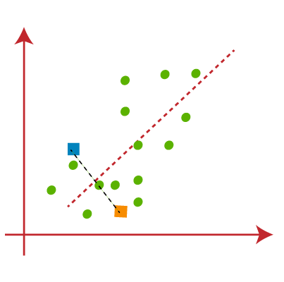
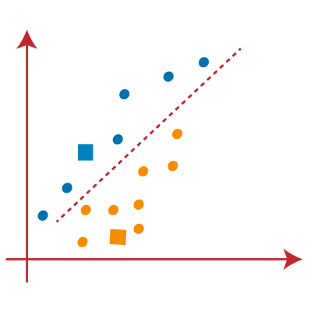
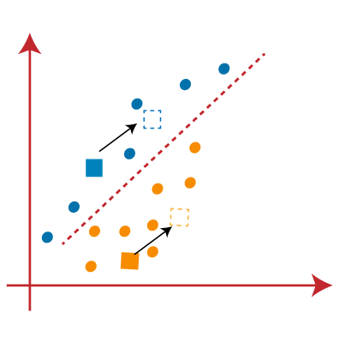
From the above image, it is clear that points left side of the line is near to the K1 or blue centroid, and points to the right of the line are close to the yellow centroid. Let's color them as blue and yellow for clear visualization.
As we need to find the closest cluster, so we will repeat the process by choosing a new centroid. To choose the new centroids, we will compute the center of gravity of these centroids, and will find new centroids as below:

Slide 8
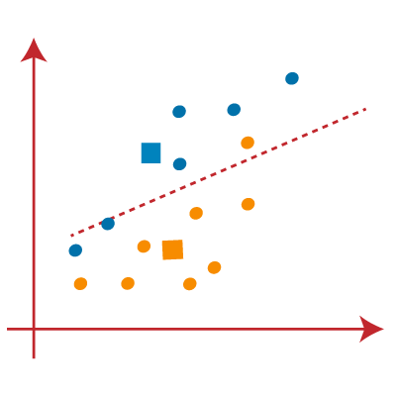
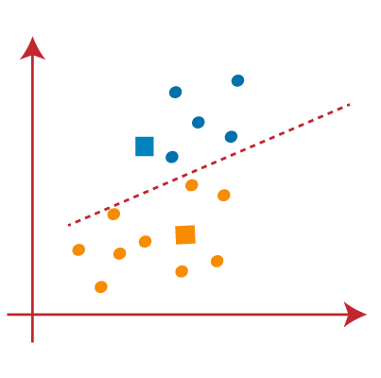
Next, we will reassign each datapoint to the new centroid. For this, we will repeat the same process of finding a median line. The median will be like below image:
From the above image, we can see, one yellow point is on the left side of the line, and two blue points are right to the line. So, these three points will be assigned to new centroids.
As reassignment has taken place, so we will again go to the step-4, which is finding new centroids or K-points.
We will repeat the process by finding the center of gravity of centroids, so the new centroids will be as shown in the below image:

Slide 9
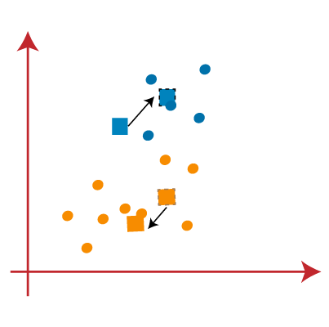
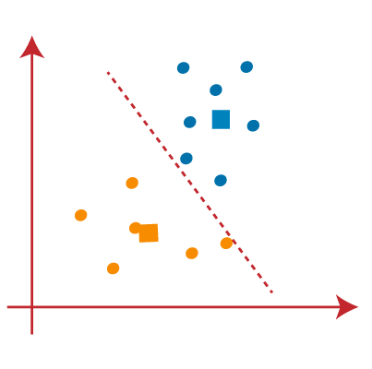
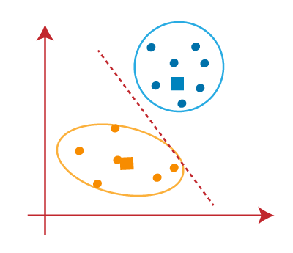
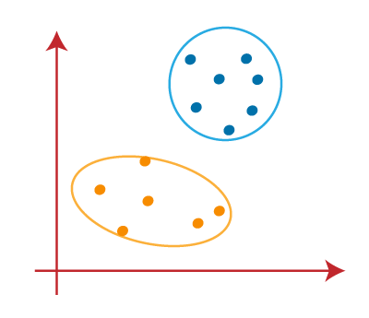
As we got the new centroids so again will draw the median line and reassign the data points. So, the image will be:
We can see in the above image; there are no dissimilar data points on either side of the line, which means our model is formed. Consider the below image:
As our model is ready, so we can now remove the assumed centroids, and the two final clusters will be as shown in the below image:

Slide 10
Hierarchical Clustering
Hierarchical clustering is another unsupervised machine learning algorithm, which is used to group the unlabeled datasets into a cluster and also known as hierarchical cluster analysis or HCA.
In this algorithm, we develop the hierarchy of clusters in the form of a tree, and this tree-shaped structure is known as the dendrogram.
Sometimes the results of K-means clustering and hierarchical clustering may look similar, but they both differ depending on how they work. As there is no requirement to predetermine the number of clusters as we did in the K-Means algorithm.
The hierarchical clustering technique has two approaches:
Agglomerative: Agglomerative is a bottom-up approach, in which the algorithm starts with taking all data points as single clusters and merging them until one cluster is left.
Divisive: Divisive algorithm is the reverse of the agglomerative algorithm as it is a top-down approach.

Slide 11
Why hierarchical clustering?
As we already have other clustering algorithms such as K-Means Clustering, then why we need hierarchical clustering? So, as we have seen in the K-means clustering that there are some challenges with this algorithm, which are a predetermined number of clusters, and it always tries to create the clusters of the same size. To solve these two challenges, we can opt for the hierarchical clustering algorithm because, in this algorithm, we don't need to have knowledge about the predefined number of clusters.
Agglomerative Hierarchical clustering
The agglomerative hierarchical clustering algorithm is a popular example of HCA. To group the datasets into clusters, it follows the bottom-up approach. It means, this algorithm considers each dataset as a single cluster at the beginning, and then start combining the closest pair of clusters together. It does this until all the clusters are merged into a single cluster that contains all the datasets.
This hierarchy of clusters is represented in the form of the dendrogram.

Slide 12
How the Agglomerative Hierarchical clustering Work?
The working of the AHC algorithm can be explained using the below steps:
Step-1: Create each data point as a single cluster. Let's say there are N data points, so the number of clusters will also be N.
Step-2: Take two closest data points or clusters and merge them to form one cluster. So, there will now be N-1 clusters.
Step-3: Again, take the two closest clusters and merge them together to form one cluster. There will be N-2 clusters.
Step-4: Repeat Step 3 until only one cluster left. So, we will get the following clusters.
Step-5: Once all the clusters are combined into one big cluster, develop the dendrogram to divide the clusters as per the problem.

Slide 13
References
T1: Mitchell T.M., Machine Learning, McGraw Hill (1997).
T2: Andreas C. Miller, Sarah Guido, Introduction to Machine Learning with Python, O’REILLY (2001).
Notes:
Introduction to Cyber Security (simplilearn.com)

Slide 14

THANK YOU

